Slide 1

Protocols of the Internet
1. april 2018

Slide 2
What is a protocol?
A protocol is a set of rules
They allow two or more entities of a communications system to transmit information
The protocol defines the rules syntax, semantics and synchronization of communication and possible error recovery methods.
Protocols may be implemented by hardware, software, or a combination of both.

Slide 3
What is their purpose?
Identify errors in communication
Compressing data
Deciding how the data is sent “over the wire”
Addressing the data
Deciding how to announce sent and received data

Slide 4
Common internet protocols
Internet Protocols
TCP/IP
IPX/SPX
FTP
TelNet
SMTP
SSH
IMAP
AppleTalk
HTTP
POP3
UDP

Slide 5
Common internet protocols (cont.)
TCP/IP
Transmission Control Protocol/Internet Protocol is the dominant standard in internetworking
TCP/IP represent a set of public standards that specify how packet of information are exchanged between computers over one or more networks.
IPX/SPX
Internetwork Packet Exchange/Sequenced Packet Exchange – Originally employed be Novell in the network operating system, NetWare.

Slide 6
Common internet protocols (cont.)
HTTP
Hyper Text Transfer Protocol governs how files, such as text, graphics, sound and video, are exchanged over the World Wide Web (WWW)
FTP
File Transfer Protocol provides services for file transfer and manipulation.
SSH
Secure Shell is used to securely connect to a remote computer
TelNet
An application used to connect to a remote computer. It lacks security features

Slide 7
Common internet protocols (cont.)
POP3
Post Office Protocol is used to download e-mail from a remote mail-server
IMAP
Internet Message Access Protocol is also used to download e-mail from a remote mail server
SMTP
Simple Mail Transfer Protocol is used to send email to a remote email server

Slide 8
The Protocol Stack
A protocol stack refers to a group of protocols that are runnning concurrently that are employed for the implementation of network protocol suite.
The protocols in a stack determine the interconnectivity rules for a layered network model such as in the OSI or TCP/IP models.
To become a stack the protocols must be interoperable being able to connect both vertically between the layers of the network and horizontally between the end-points of each transmission segment.
User / Application
Brower (Chrome, Firefox, etc.)
Application Layer
HTTP, SMTP, IMAP, FTP
Transport Layer
Network Layer
Link Layer
Hardware Layer
TCP, UDP
IP
Ethernet driver
Ethernet

Slide 9

Transmission Control Protocol

Slide 10
Transmission Control Protocol
TCP provides a reliable transmission of data in an IP environment.
TCP provides stream data transfer, reliability, efficient flow control, full-duplex operation and multiplexing.
Stream data is a data transfer of unstructured stream of bytes, identified by a sequence number.
This benefits application, since they are not required to divide data into chunks, TCP will handle it.
TCP offers reliability by providing connection-oriented, end-to-end reliable packet delivery
It does this by sequencing bytes with a forwarding acknowledgement number.

Slide 11
Transmission Control Protocol (cont.)
Bytes that are not acknowledged within a given timeframe are re-transmitted.
This reliability mechanism allows devices to deal with lost, delayed, duplicate or misread packets.
Full-duplex operation allows TCP processes to both send and receive at the same time.
Multiplexing means that numerous simultaneous upper-layer conversations can be multiplexed over a single connection.

Slide 12
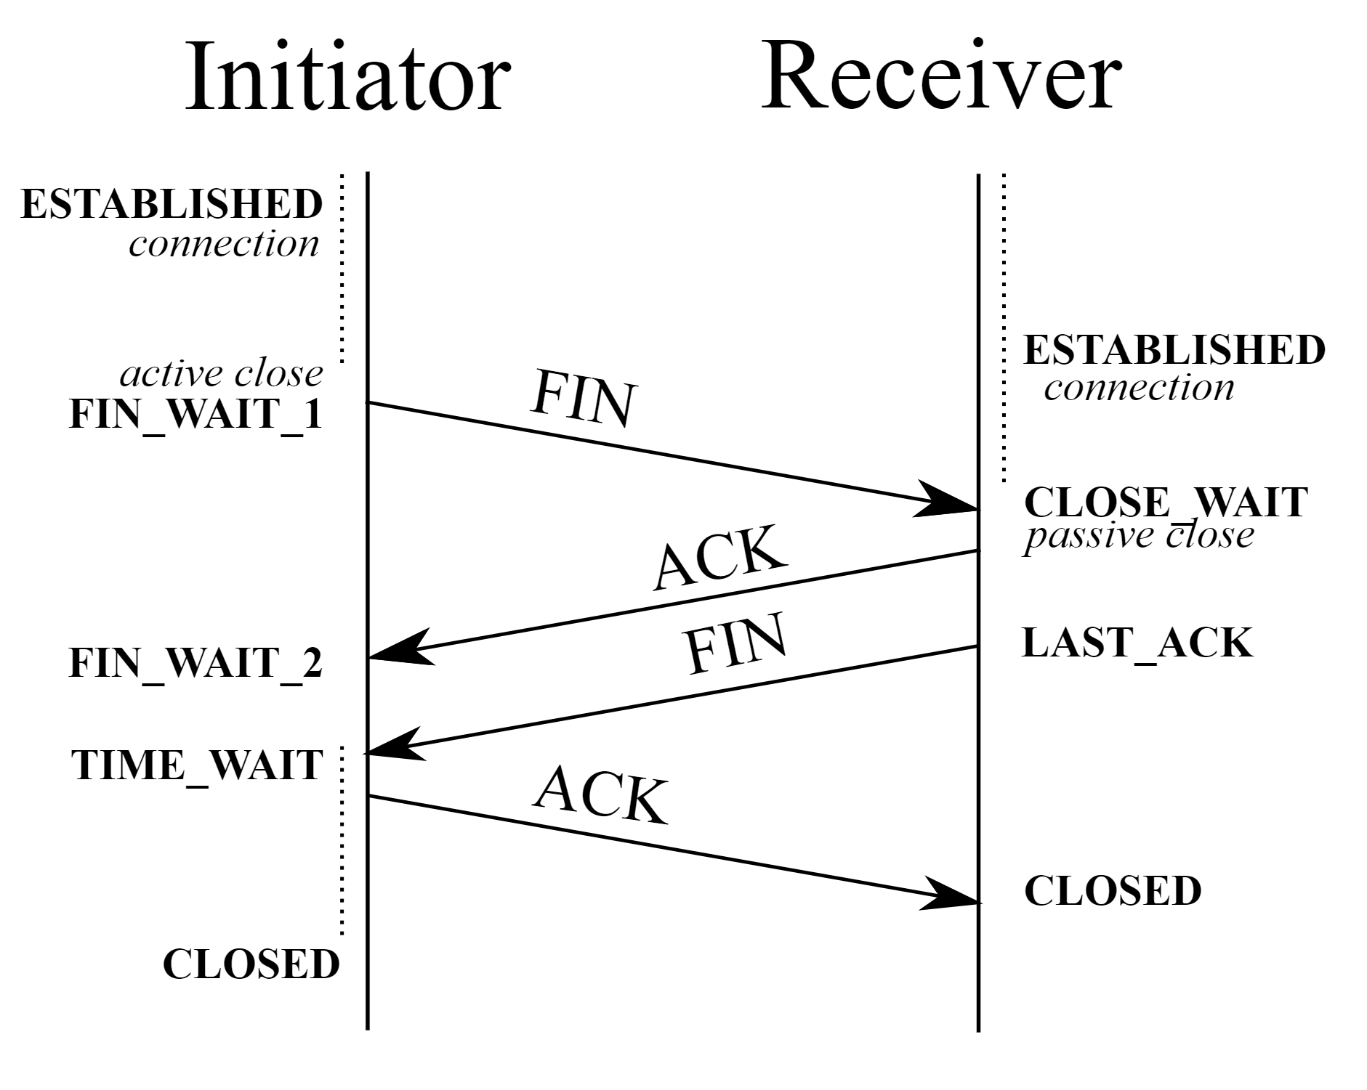
Transmission Control Protocol (cont.)
Connection establishment
SYN The active open is performed by the client sending a SYN package to the server
SYN-ACK In response, the server replies with a SYN-ACK package
ACK Finally, the client sends ACK package back to the server.
This is a known as a three-way handshake

Slide 13

User Datagram Protocol

Slide 14
User Datagram Protocol
UDP is a connectionless transport-layer protocol.
It belongs to the Internet Protocol family
UDP is basically an interface between IP and upper-layer processes
UDP uses ports to distinguish multiple applications running on a single device.
Unlike TCP, UDP adds no reliability, flow-control or error-recovery.
Resulting in less overhead, due to smaller header size

Slide 15
User Datagram Protocol (cont.)
When might UDP be a better option, than TCP?

Slide 16
User Datagram Protocol (cont.)
UDP is the transport protocol for several well-known application-layer protocols, including:
Network File System (NFS)
Simple Network Management Protocol (SNMP)
Domain Name System (DNS)
Trivial File Transfer Protocol (TFTP)

Slide 17

HyperText Transfer Protocol

Slide 18
HyperText Transfer Protocol
HTTP is the foundation for data communication of the World Wide Web (WWW)
It is an application layer protocol
Used for transferring various forms of data between server and client
Such as plaintext, hypertext, images, videos and sound

Slide 19
A stateless protocol
HTTP is a stateless protocol, because the HTTP server maintains no information about the clients.
If a particular client asks for the same object twice in a period of a few seconds, the server has no knowledge that it just served the object.
The server just resends the object.

Slide 20
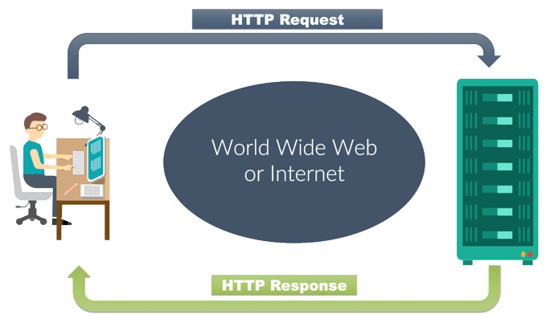
How does HTTP work?
HTTP is implemented in two “programs”:
Client
Server
The client initiates a TCP connection with a server.
Once the connection is established (three-way handshake), the client and server processes TCP through their socket interfaces.

Slide 21
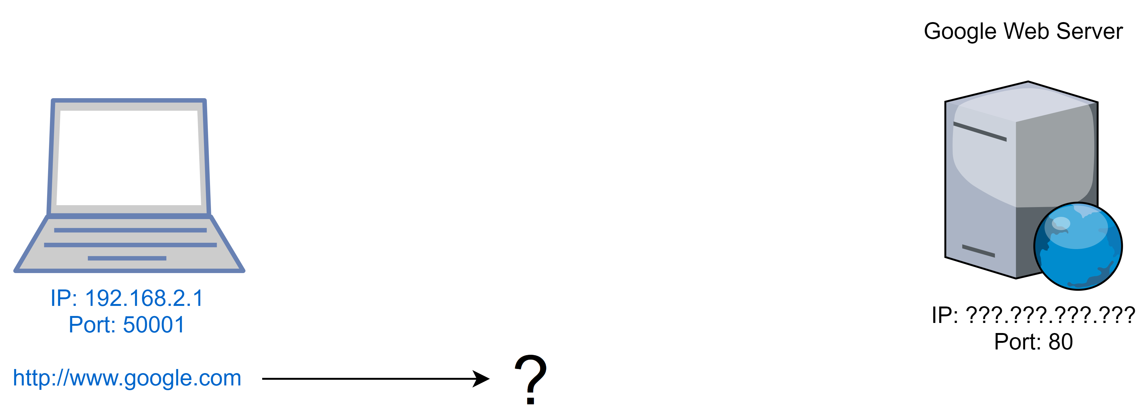
Opening a website

Slide 22
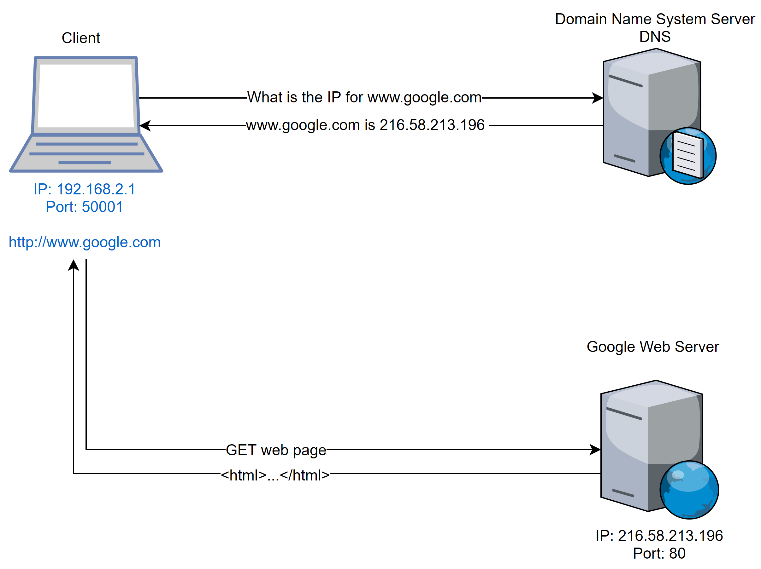
Opening a website (cont.)

Slide 23
Connection Persistence
HTTP allows for Connection Persistency
If a connection is persistent, all request/response pair is sent over a single TCP connections
If a connection is non-persistent, each request/reponse pair is sent over separate TCP connections

Slide 24
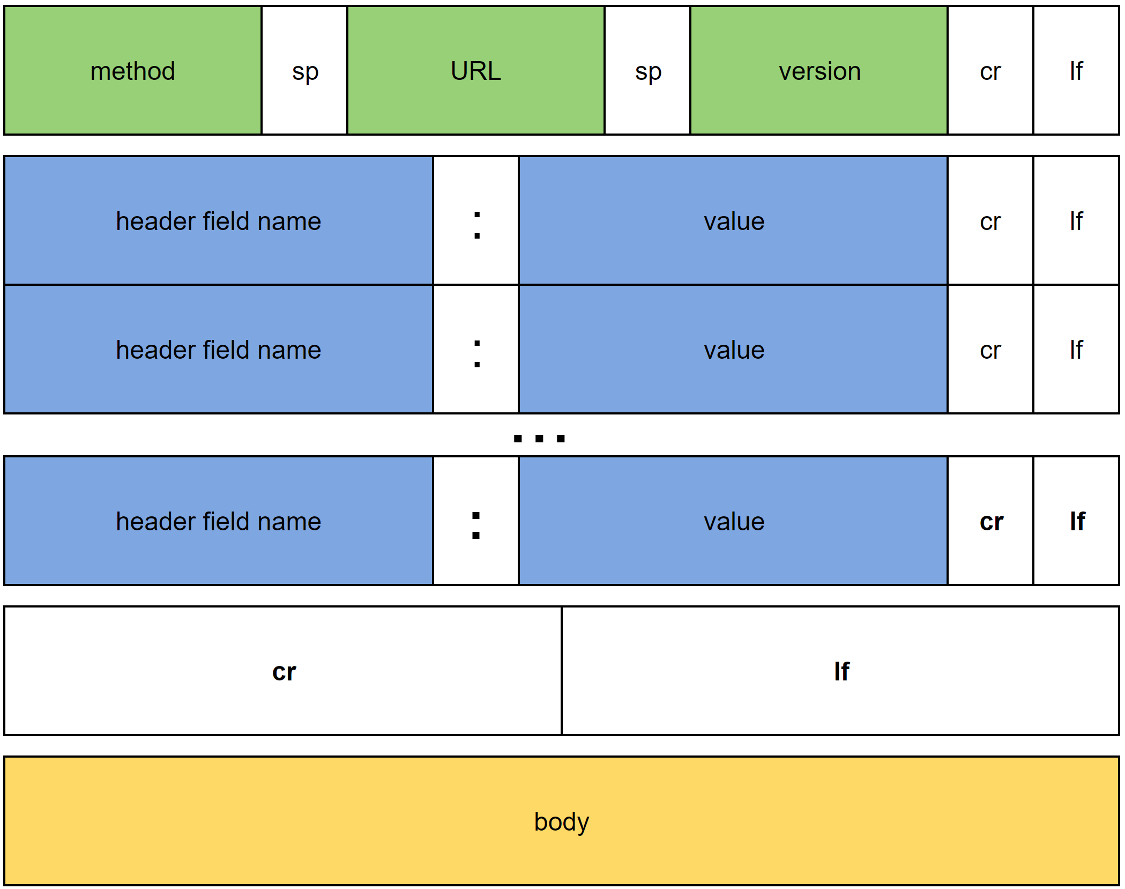
HTTP Request message
First line is called request line
Subsequent lines are header lines
Request line has three fields, method, URL and version
Method field can take several different values, such as GET, POST, DELETE etc.
The majority of HTTP request are GET requests.

Slide 25
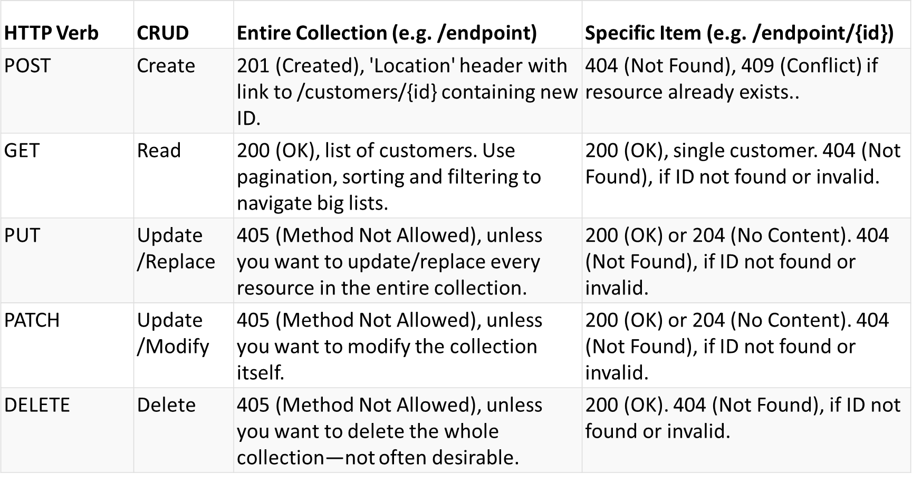
Request methods

Slide 26

HTTP Response Message
It has three sections, status line, header lines and entity body.
The entire body contains the requested object itself.
The status line has three fields:
Protocol version
Status code
Status message

Slide 27
HTTP Status Codes - Overview
Status code range | Responsibility
1xx | Informational responses
2xx | Success
3xx | Redirection
4xx | Client error
5xx | Server error

Slide 28
HTTP Status Codes – 1xx
Status Code | Name | Description
100 | Continue | The server has received the request headers and client should proceed to send request body.
101 | Switching protocols | The requester has asked the server to switch protocols and the server has agreed to do so.
102 | Processing | A WebDAV request may contain sub-requests involving file operations, requiring long time to process.
103 | Early hints | Used to return some response headers before file HTTP message.

Slide 29
HTTP Status Codes – 2xx
Status code | Name | Description
200 | OK | Standard response for successful HTTP requests.
201 | Created | The request has been fulfilled and a new entity has been created
202 | Accepted | Request has been accepted for processing, but processing is not done.
203 | Non-Authoritative Information | A transforming proxy that received a 200 OK from its origin, but is returning a modified version of the origin's response.
204 | No Content | Successfully processed the request and is not returning any content
205 | Reset Content | Same as 204, except this requires that the requester reset the document
206 | Partial Content | Delivering only part of the resource due to a range header sent by the client.
207 | Multi-Status | The message body that follows is by default an XML message
208 | Already reported | The members of a DAV binding have already been enumerated
226 | IM Used | The server has fulfilled a request for the resource, and the response is a representation of the result of one or more instance-manipulations applied to the current instance.

Slide 30
HTTP Status Codes – 3xx
Status code | Name | Description
300 | Multiple choices | Indicates multiple options for the resource from which the client may choose.
301 | Moved Permanently | This and all future requests should be directed to the given URI.
302 | Found | Requires the client to make a temporary redirect.
303 | See other | Response to the request can be found under another URI using the GET method.
304 | Not Modified | Indicates that the resource has not been modified. No need to retransmit the resource.
305 | Use proxy | The requested resource is available only through a proxy
306 | Switch proxy | No longer used. Subsequent requests should use the specified proxy.
307 | Temporary redirect | Request should be repeated with another URI; however, future requests should still use the original URI.
308 | Permanent redirect | The request and all future requests should be repeated using another URI.
Notes:
popular browsers implemented 302 with the functionality of a 303 See Other. Therefore, HTTP/1.1 added status codes 303 and 307 to distinguish between the two behaviours.^{[23]} However, some Web applications and frameworks use the 302 status code as if it were the 303.^{[24]}
307 and 308 parallel the behaviors of 302 and 301, but do not allow the HTTP method to change. So, for example, submitting a form to a permanently redirected resource may continue smoothly.^{[31]}

Slide 31
HTTP Status Codes – 4xx
Status code | Name | Description
400 | Bad request | The server cannot or will not process the request due to an apparent client error
401 | Unauthorized | Authentication is required and has failed or has not yet been provided.
403 | Forbidden | Request was valid, but the server is refusing action.
404 | Not found | Requested resource could not be found but may be available in the future.
405 | Method not allowed | A request method is not supported for the requested resource
410 | Gone | Indicates that the resource requested is no longer available and will not be available again.
415 | Unsupported media type | The request entity has a media type which the server or resource does not support
418 | I’m a teapot | Defined in 1998 as one of the traditional IETF April Fools' jokes
451 | Unavailable for legal reasons | A server operator has received a legal demand to deny access to a resource or to a set of resources that includes the requested resource.

Slide 32
HTTP Status Codes – 5xx
Status code | Name | Description
500 | Internal server error | A server operator has received a legal demand to deny access to a resource or to a set of resources that includes the requested resource.
501 | Not implemented | The server either does not recognize the request method, or it lacks the ability to fulfil the request.
502 | Bad gateway | The server was acting as a gateway or proxy and received an invalid response from the upstream server.
503 | Service unavailable | The server is currently unavailable (because it is overloaded or down for maintenance). Generally, this is a temporary state.
504 | Gateway timeout | The server was acting as a gateway or proxy and did not receive a timely response from the upstream server.
505 | HTTP Version not supported | The server does not support the HTTP protocol version used in the request.

Slide 33
Cookies: client-server interactions
Since HTTP is stateless, it simplifies server design and has allowed engineers to create high performant web servers.
However it is often desirable to allow a website to identify a given user.
To allow this, cookies are used.
Cookies consists of 4 components
Header line in HTTP Response message
Header line in HTTP Request message
Local file on users computer (managed by the client)
A data store of some kind on the web site server

Slide 34
Caching the web
Also known as proxying.
It is an network entity that satisfies a given HTTP request on behalf of the origin web server
The web cache has its own disk storage and keeps copies of recently requested objects
Caching can substantially reduce response times for a request.
Examples: Cloudflare, CloudFront, Akamai (All three do more than caching)

Slide 35

HyperText Transfer Protocol over SSL

Slide 36
HTTPS – Do you need it?
Yes! But why? Tell me!

Slide 37
Why you need HTTPS
HTTP is a 15-year-old protocol
The World Wide Web is built upon HTTP
The issue with HTTP is that everything is sent in cleartext, i.e. unsecured.
This makes websites using HTTP vulnerable, since data can be intercepted and even manipulated.

Slide 38
HTTPS then
HTTPS uses end-to-end encryption to ensure the integrity of the transmitted data.
Today it uses TLS (Transport Layer Security), previously it used SSL (Secure Sockets Layer)
HTTPS is a superior protocol, yet the adoption rate has been limited.

Slide 39
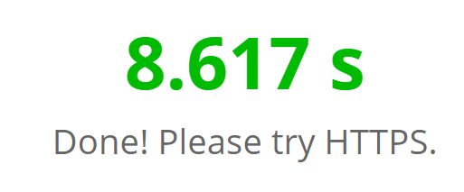
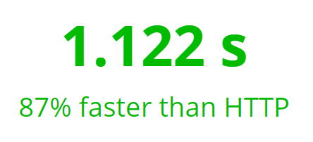
HTTPS is slower than HTTP?
HTTPS is slower than HTTP
Many (falsely) accuse HTTPS for being slower. It is often attributed to the added overhead used for encrypting and decrypting.
Test it yourself at: www.httpvshttps.com

Slide 40
HTTPS – why it is awesome
Allows us to use HTTP/2
Encryption protects your website from attacks, specifically Man-in-the-Middle attacks
Advocates care for your users, since you encrypt their communication with your website
User / Application
Brower (Chrome, Firefox, etc.)
Application Layer
HTTP, SMTP, IMAP, FTP
Transport Layer
Network Layer
Link Layer
Hardware Layer
TCP, UDP
IP
Ethernet driver
Ethernet
Encryption Layer
SSL or TLS

Slide 41

File Tranfer Protocol

Slide 42
File Transfer Protocol
FTP is simple protocol for transferring files over a network
FTP does not move files, it copies them
An FTP client is a piece of software specifically designed for moving files between two computers
FTP is stateful, HTTP is not ☺
FTP uses a TCP connection
FTP transfers one file at a time

Slide 43
FTP vs HTTP
As mentioned FTP is stateful, HTTP is stateless
FTP generally encodes data to binary. HTTP uses MIMEm

Slide 44
Connection types
An FTP connection be either passive or active.
The client determines whether it uses an active or passive connection.
The connection type determines how the FTP server responds and on what ports transactions will occur.
Active connections: When an active connection is established, the server opens a data connection to the client from port 20 to a higher-order port number. All data is passed over this connection.
Passive connections: When a passive connection is established, the client asks the FTP server to establish a connection to a port higher than 10.000. The server relays the port back to the client, and the client establishes a connection to the given port. Each request will result in a separate connection

Slide 45
FTP problems
FTP sends files in clear plain-text (like HTTP)

Slide 46

Secure File Transfer Protocol

Slide 47
Secure FTP
SFTP uses SSH to securely transfer files.
Unlike FTP, SFTP encrypts both commands and data
It functions similarly to FTP, but you cannot use a standard FTP client
SFTP uses encryption and X.509 certificates
Numerous encryption algorithms can be used.

Slide 48
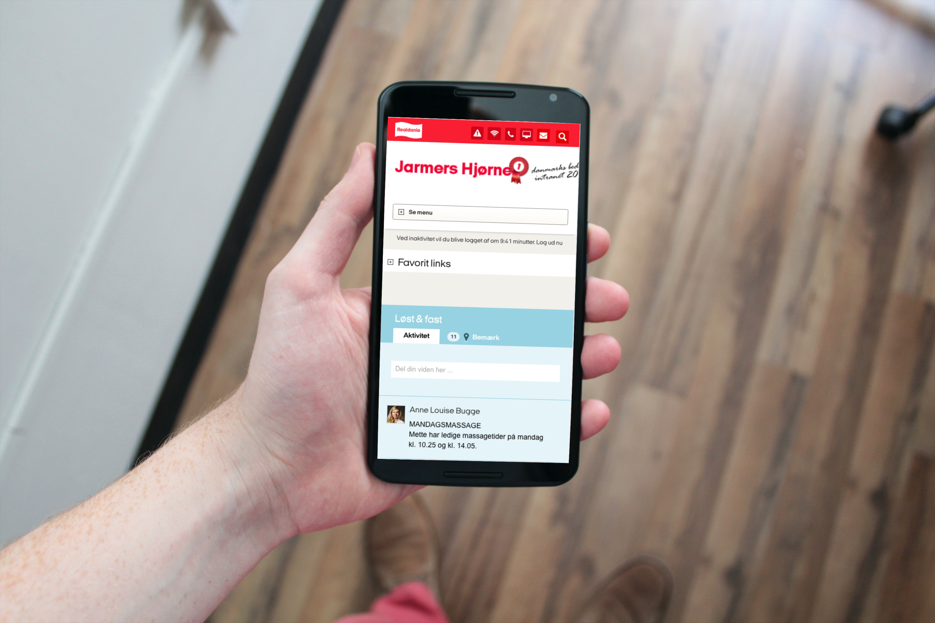
Questions?

Slide 49

Brugbare elementer
Dobbeltklik for at ændre farve eller indsætte baggrundsbillede

